Slide 1
README
BURN AFTER READING
about_SlideDeck
The actual presentation starts with slide 6 ("Session title"). The first five slides have a purely organisational purpose. During the break before your session, you should start the presentation with slide 2 ("Next up"), so that the audience knows that they are in the right room. It's fine if you start chatting with the audience during this break, but we need a precise starting point for your presentation in terms of editing your video. That means:
The recording of your presentation will start after the countdown. Please (RE)START talking after the countdown, not during it! Otherwise your recording will start with a half sentence.
It is not necessary to explicitly signal to the PA operator, this is your signal!
Finally, do you have to use this slide deck? No, you are free to present the way you like it. But you are asked to use the intro slides: countdown, session title, sponsor slide. Beyond that, use what is good for the cause – from no slides to sketches from your children, from Jupyter to $youNameIt.
You will find additional information in the notes below.
Sincerely, your hosts!
Dear Speaker, we are thrilled and honored to have you with us in Antwerp in 2024. Take your time and read this before you prepare your session.
Since most of you have been with us before, you will already know a lot about PSConfEU. You know that we try to capture all sessions carefully and publish your work on YouTube. There are a few easily avoidable stumbling blocks that we would like to draw your attention to:
Your screen resolution should be 1920x1080 px (FullHD)
You should provide a full size HDMI socket
Mirror your screen
Disable "Presenter View" in PowerPoint
Using MAC or Surface book? Be aware of HDCP!
Notes:
The fine print (additional information)
Why should you care about HDCP?
"High-bandwidth Digital Content Protection (HDCP) is a form of digital copy protection developed by Intel Corporation to prevent copying of digital audio and video content as it travels across connections. Types of connections include DisplayPort (DP), Digital Visual Interface (DVI), and High-Definition Multimedia Interface (HDMI), as well as less popular or now deprecated protocols like Gigabit Video Interface (GVIF) and Unified Display Interface (UDI)."
https://en.wikipedia.org/wiki/High-bandwidth_Digital_Content_Protection
Some notebooks ignore the HDCP standard, some vendors comply with the standard. Apple and Microsoft are somehow famous for strictly following the HDCP guidelines. Sadly, we will not be able to guarantee, that your session can be recorded in the latter case.
But you can do simple things, to overcome these problems. It is also very likely that you presented with your notebook before. So you will know, if this worked fine.If you are in doubt and if the agenda allows, try a dry-run a day before and connect everything.
In general you can easily bypass HDCP restrictions with a cheap splitter (the cheaper the better), just like the one you see below. This is an example device that we bought for 16 euros (in Germany).
Ask us, we will lend you such a device.
Thorsten also gave a whole presentation about "Broadcasting yourself" - easy steps to record yourself and create a (backup) session recording on your own. If you want to invest your time and dive deeper, take a look at his recordings and notes:
https://vimeo.com/thorstenbutz/byourself
This is of course completely voluntary, but perhaps you will find it helpful.

Slide 2
Instructions
Use this template if you want, it’s preferred but not mandatory.
Please make sure our sponsors are mentioned on your first slide after the title.
Do not amend the ratio or the colours of the sponsors’ logo and background.
Update your twitter handle through the master page (see next slides).

Slide 3
Instruction (Continued)
The session is 30 min.
Then 15min Q&A.
At the end of your 45 min, please leave the room to the next speaker.
You’re welcome to continue the discussion in the Foyer area.

Slide 4
Next Up:
Jess Pomfret
Creating beautiful reports with the PSHTML module

Slide 5
3
3

Slide 6
2

Slide 7
1

Slide 8
Creating beautiful reports with the PSHTML module
Jess Pomfret

Slide 9

Many thanks to our sponsors:

Slide 10




Jess Pomfret (she/her)
Data Platform Engineer
Open Source Contributor
Passionate about SQL Server, PowerShell & Proper Football
jpomfret7@gmail.com
linkedin.com/in/jpomfret/

Slide 11
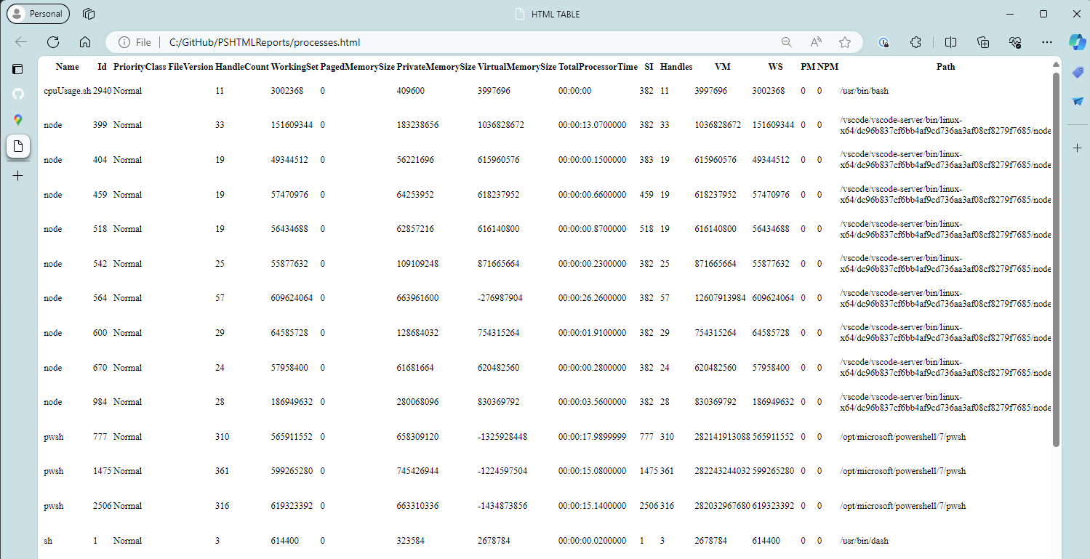
Get-Process | ConvertTo-Html | Out-File .\processes.html

Slide 12
Creating reports with the PSHTML module
BEAUTIFUL
Jess Pomfret

Slide 13
PSHTML
Community Module by Stéphane van Gulick
Cross Platform
DSL – Domain Specific Language
Renders HTML using PowerShell
Notes:
DSL
specialized to a particular application domain
Higher level of abstraction
HTML is also a DSL

Slide 14
PSHTML → HTML
h1 -Content 'Hi PSConfEU'
p -Content 'This is a paragraph’
ConvertTo-PSHTMLTable -Object $data
<h1 >Hi PSConfEU</h1>
<p >This is a paragraph</p>
<Table >
<thead >
<tr >
<th >Age</th>
<th >Location</th>
<th>Name</th>
</tr>…

Slide 15
Useful Features
PowerShell language:
conditionals, loops, switches
To generate HTML
Headings, lists, forms, tables, charts
Notes:
Conditionals – output certain HTML depending on the conditions, if this is true add another table
Loops – duplicate html elements with sight differences, passed in from what you’re looping over

Slide 16
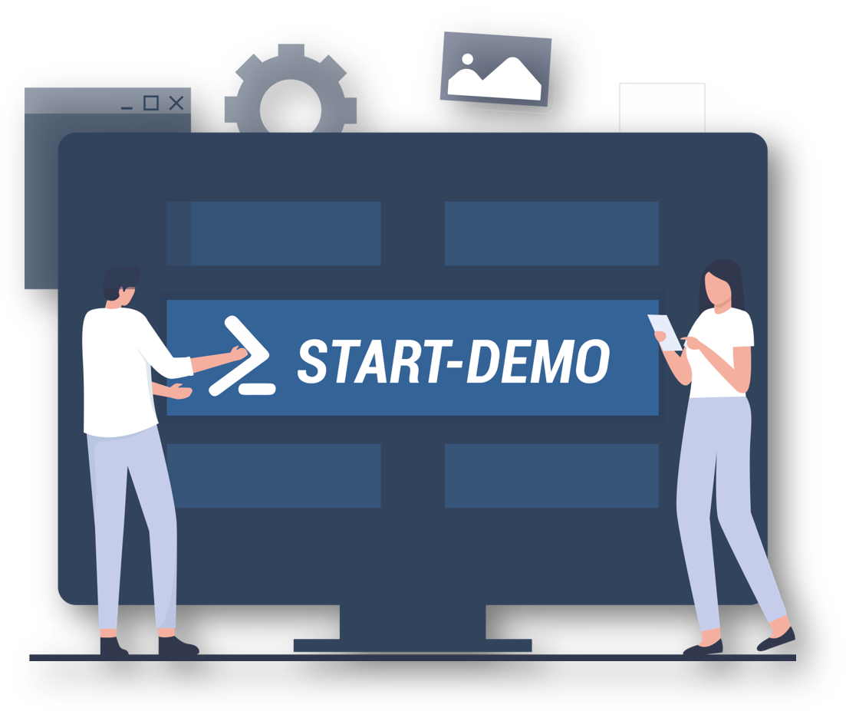

Demos
jpomfret/PSHTMLReports

Slide 17

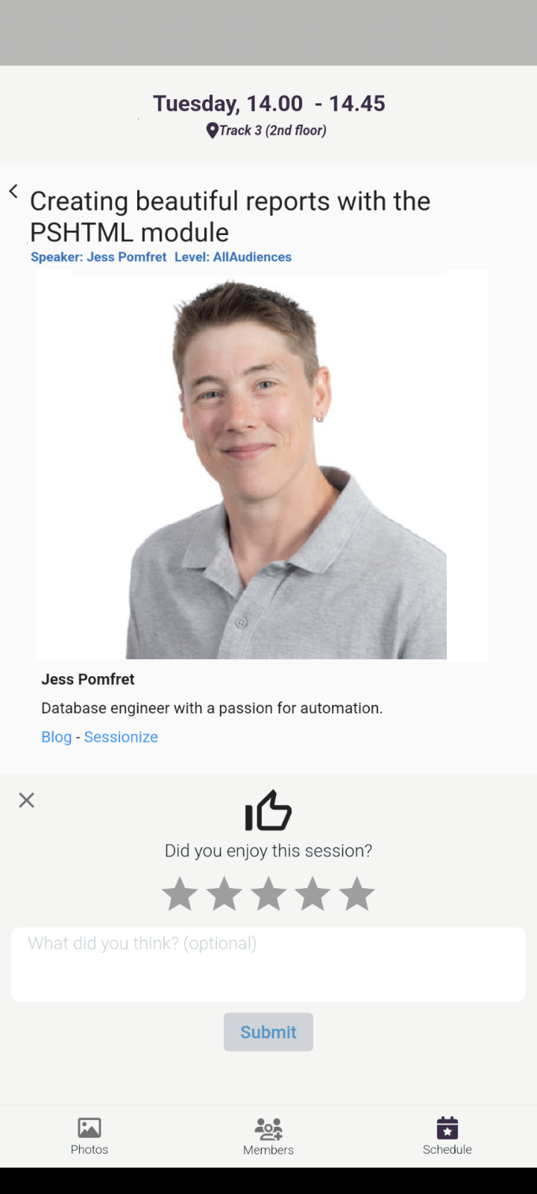
Q&A
15 minutes
jpomfret/PSHTMLReports
jpomfret7@gmail.com
linkedin.com/in/jpomfret/

